Slide 1




WEATHER FORECASTING TOOL
Presentation by Shruti Avhad
CSE 3rd Year IIT (BHU) Varanasi

Slide 2


Introduction
A command-line tool that accepts a city's name and returns the current weather forecast. Leveraging OpenWeatherMap API to fetch weather data and parse it using Python.
Using Github copilot for API usage, data parsing, and error handling.

Slide 3
USECASES
Agriculture: Farmers use weather forecasts to plan their planting and harvesting schedules, and predict the risk of crop damage from drought, flooding.
Air travel: To plan their flight schedules and to make decisions about whether to cancel or delay flights. They also use weather forecasts to predict the risk of turbulence and other weather-related hazards.
Construction: To plan their work schedules and to make decisions about whether to postpone or cancel construction projects. They also use weather forecasts to predict the risk of damage to construction sites from weather events.
Emergency management: To plan for and respond to natural disasters, such as hurricanes, floods, and tornadoes. They also use weather forecasts to warn the public about potential weather hazards.
Recreation: People who enjoy outdoor activities, such as hiking, camping, and fishing, use weather forecasts to plan their activities and to stay safe in the outdoors.

Slide 4


PROBLEM STATEMENT
Create a command-line tool that accepts a city's name and returns the current weather forecast. Leverage OpenWeatherMap API to fetch weather data and parse it using Python. Your solution should demonstrate how GitHub Copilot can help you with API usage, data parsing, and error handling.

Slide 5
PROPOSED SOLUTION
nbjjvjbjwdsdaef
OpenWeatherMap provides an API with JSON, XML, and HTML endpoints.
Steps:
Take City Name as input
Create the base URL using API key and CityName
Get response from OpenWeatherMap
Using json method of response object, convert json format data into python format data, it contains a list of nested dictionaries.
Checking for cod value:
if cod!='200' #City not Found and response reset
else #City found and then,
Parse the response and store the information.

Slide 6
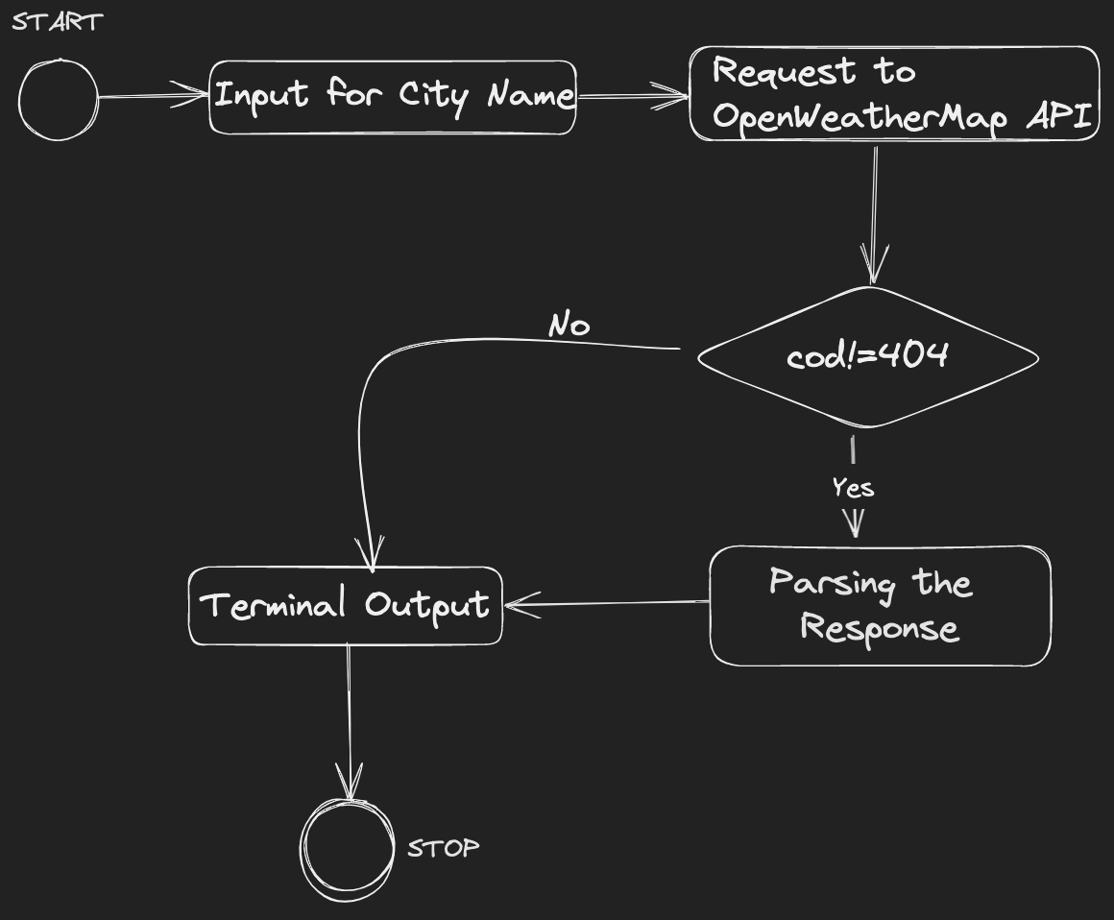
HIGH LEVEL ARCHITECTURE

Slide 7

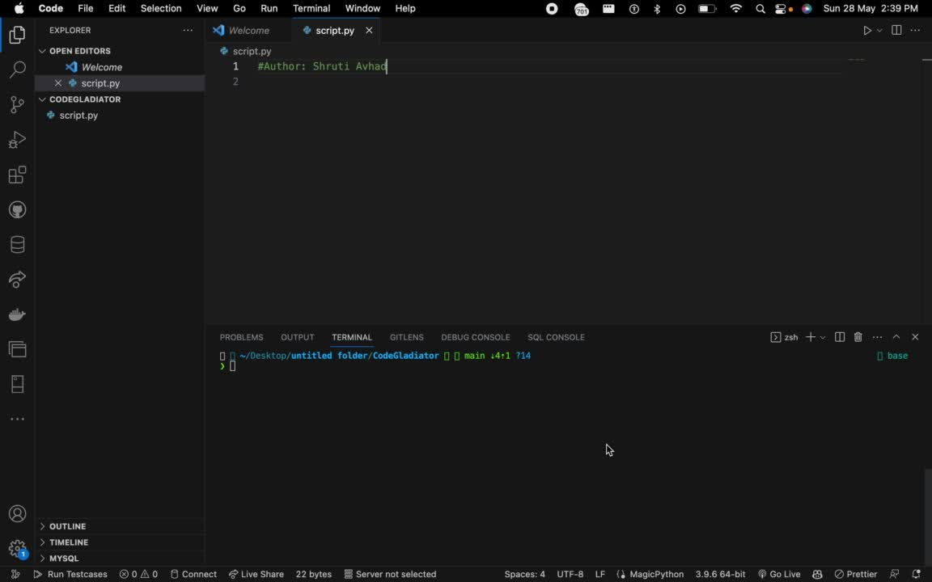
IMPLEMENTATION

Slide 8
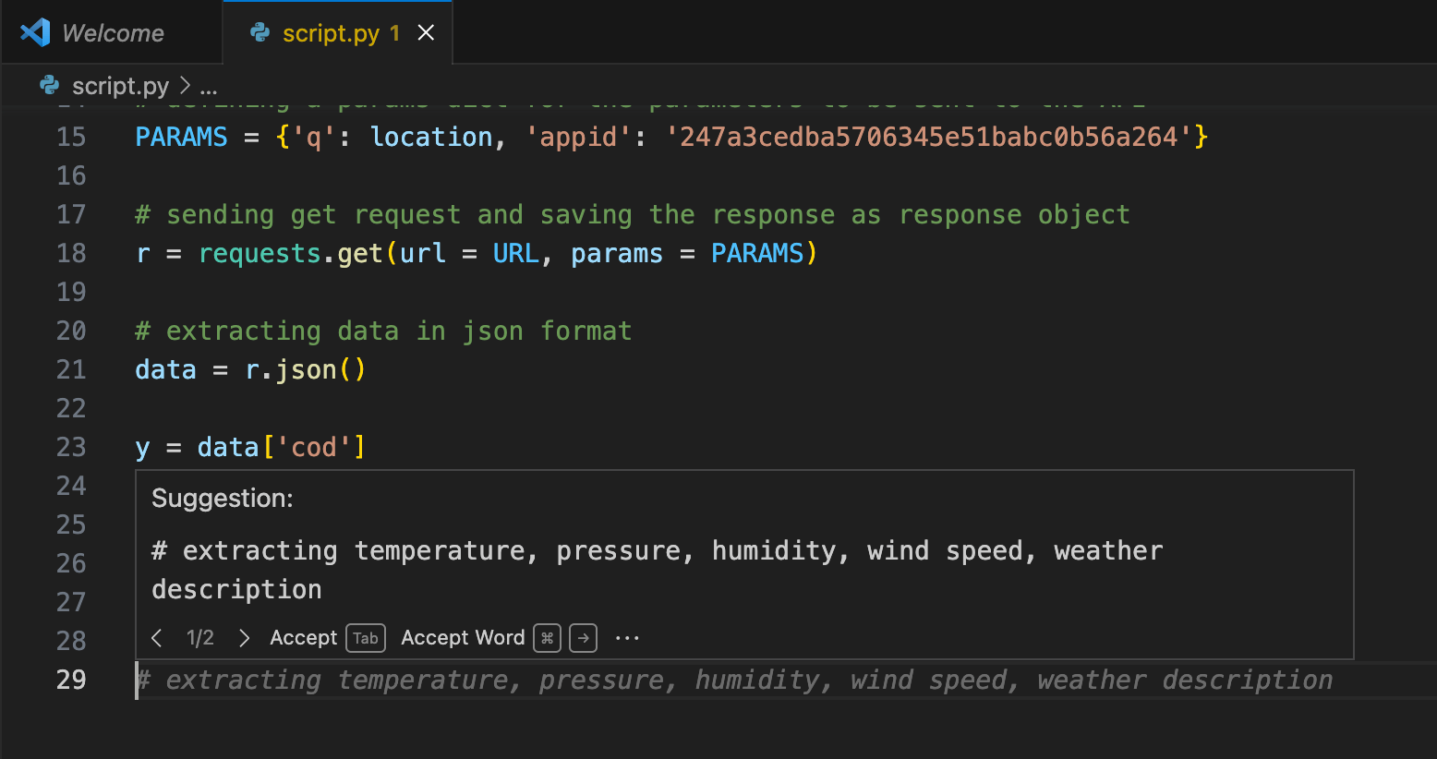
GITHUB-COPILOT
Github Copilot helps in API usage, data parsing, and error handling.
GitHub Copilot uses the OpenAI Codex to suggest code and entire functions in real-time, right from our editor.
Copilot gives suggestions to write code and gives prompt for the same.

Slide 9
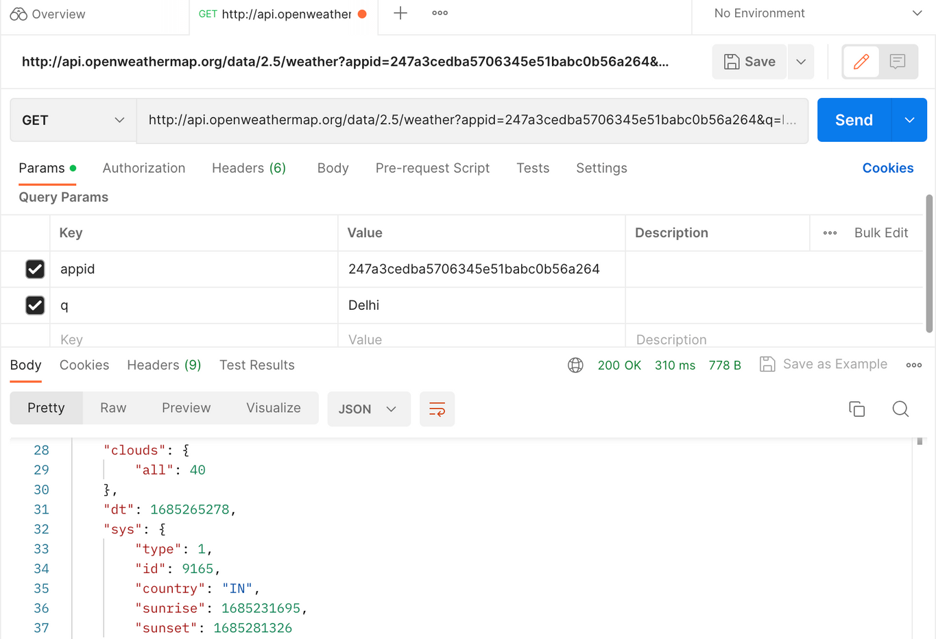
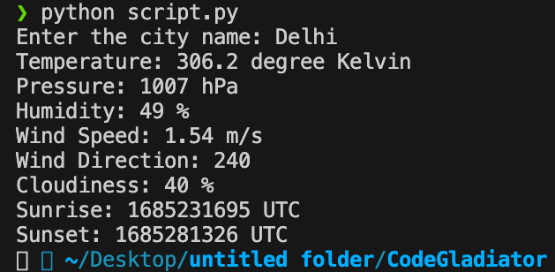
RESPONSE FROM OPENWEATHERMAP
Getting the Response and Parsing it to get the required parameters.
Also, checking the response on postman.

Slide 10

INNOVATION
We can integrate this system with a web/android app to derive these updates for various use-cases as suggested in previous slide.
Using a GUI could also improve its functionalities.
Can also use an updated version of GitHub Copilot for advanced usage for code writing and error handling.

Slide 11
Thank you
Presentation by Shruti Avhad
CSE 3rd Year IIT (BHU) Varanasi

